Slide 1
SAOCOM InSAR Digital Elevation Model Validation Study
Land cover-stratified accuracy and spatial coverage analysis — Verona region
Notes:
Study components: point cloud validation, land cover-stratified assessment, void analysis, multi-dataset comparison.

Slide 2
Datasets & Study Area
SAOCOM: L-band InSAR point cloud (CSV with LAT2, LON2, HEIGHT, COHER).
TINITALY: 10 m reference DEM.
Copernicus GLO-30: 30 m reference DEM.
CORINE 2018: Land cover classification (level 3).
Sentinel-2: RGB imagery (bands B04/B03/B02).
Coordinate System: UTM Zone 32N (EPSG:32632).
Study area: convex hull around SAOCOM points in Verona (~52.04 km²).
Notes:
All datasets reprojected to EPSG:32632 and resampled to 10 m grid for comparison.

Slide 3
Processing Parameters
Coherence filtering: γ ≥ 0.3 to remove temporally unstable points.
Target grid resolution: 10 m, NODATA value: -9999.
Resampling: Cubic for continuous DEMs; Nearest neighbor for CORINE (categorical).
k-NN isolated point removal: k=5, distance threshold=100 m.
Valid-data mask: rasterized convex hull from SAOCOM points.
Notes:
Coherence & k-NN parameters chosen to balance point retention and noise suppression; cubic resampling preserves terrain continuity.

Slide 4
Data Preprocessing Steps
SAOCOM: CSV loaded, columns standardized, numeric casting, invalid points removed (LAT2/LON2 != 0).
Applied coherence filter (γ ≥ 0.3) then reprojected to UTM32N.
Removed spatially-isolated points using k-NN (k=5, 100 m).
Reference DEMs: reprojected to UTM32N and resampled to 10 m using cubic interpolation.
Masked DEMs to SAOCOM convex hull and sampled DEM values at SAOCOM point pixel indices.

Slide 5
Height Calibration Methodology
Calibration approach: constant offset correction using robust median on stable points.
Stable point criteria: Coherence ≥ 0.8, valid reference height, |HEIGHT_RELATIVE| < 1000 m (outlier guard).
TINITALY offset = median(Ref - SAOCOM_rel) = 4.308 m (N stable points = 46,920).
Copernicus offset = 4.761 m (N stable points = 46,939).
SAOCOM_Absolute = SAOCOM_Relative + offset.
Median used to avoid influence of long-tail outliers.

Slide 6
Reference DEM Cross-Comparison
Comparison: TINITALY (10 m) vs Copernicus (30 m resampled to 10 m).
Valid pixels compared: (masked region) — benchmark agreement.
Mean diff / Median diff ~ near zero; RMSE = 4.68 m; NMAD = 2.18 m.
Computed: min/max, std, MAE, correlation and directional breakdown (TINITALY higher / Copernicus higher / roughly equal using NMAD tolerance).

Slide 7
Statistical Metrics Definitions
Bias (ME): mean(Dataset1 - Dataset2).
RMSE: sqrt(mean((Δh)^2)) — sensitive to outliers.
MAE: mean(|Δh|).
Std Dev: standard deviation of differences.
NMAD: 1.4826 × median(|Δh - median(Δh)|) — robust spread estimator.
LE68/LE90/LE95: percentiles of |Δh| (68/90/95).

Slide 8
Height Statistics Summary
Summary statistics (selected):
- SAOCOM (relative) sample stats at points: (N = 1) -- see output CSVs for full table.
- TINITALY @ SAOCOM points: [mean, median, std, min, max].
- Copernicus @ SAOCOM points: [mean, median, std, min, max].
Comparison summary:
- SAOCOM - TINITALY: RMSE = 15.25 m, NMAD = 5.24 m.
- SAOCOM - Copernicus: RMSE = 15.40 m, NMAD = 4.79 m.
Note: Full numerical tables were exported to results/ as CSV for reproducibility.

Slide 9
Visualization - Reference DEM Comparison
8-panel figure (TINITALY map, Copernicus map, differences, histograms) — saved in results/ (reference_dem_8panel.png) if available.

Slide 10
Coverage Analysis
Total 10 m cells (study area): 520,380
SAOCOM occupied cells: 67,613
Void cells (no data): 452,767 — Void percentage: 87.0%
Void mask raster saved: results/saocom_void_mask.tif (boolean raster: 0=data, 1=void).

Slide 11
CORINE Land Cover Processing
DBF lookup used to remap CORINE Value → CODE_18 → LABEL3 (level 3 classes).
Remapped raster resampled to 10 m using nearest neighbor and masked to hull.
Colorblind-friendly palette applied (grouped by 1xx/2xx/3xx/4xx/5xx).
Classes present: see results/corine_classes_present.csv; maps exported as landcover_{code}_{name}.png

Slide 12
Land Cover Sampling at SAOCOM Points
CORINE raster sampled at each SAOCOM point location via row/col of 10 m grid transform.
Points outside grid bounds and NoData were removed.
Resulting analysis table: saocom_lc_analysis DataFrame (exported to results/).

Slide 13
Height Residuals by Land Cover
Grouped by CORINE Level 3 classes; minimum 50 points per class enforced.
Metrics: N_points, median_diff_m, mean_diff_m, std_dev_m, NMAD_m.
Residual = Calibrated SAOCOM Height - TINITALY reference.
Results show urban areas with low spread; vineyards and orchards show large spread and high NMAD.

Slide 14
Void Analysis by Land Cover
Per-class metrics: total cells, void_cells, area_km2, void_area_km2, pct_LC_is_void, pct_of_total_voids.
Filter: area > 1.0 km² to remove tiny patches.
Top void classes (examples): Vineyards (99.7% void), Non-irrigated arable land (98.6%).

Slide 15
Violin Plot Analysis - Overall Comparison
Violin plots (SAOCOM-TIN, SAOCOM-COP) saved in results/violin_overall.png if generated. Plots include coherence-binned violins and overall distributions.

Slide 16
Violin Plot Analysis - By Land Cover
Common CORINE codes with N≥50 plotted (outliers trimmed to 0.5th-99.5th percentile).
Synchronized X axis across TIN/COP comparisons with 5% padding for comparability.
Three modes: TINITALY-only, Copernicus-only, side-by-side comparison.

Slide 17
CORINE Land Cover Map
CORINE map (masked) should be in results/corine_map_masked.png. Legend shows only classes present; scale bar lower right.

Slide 18
Sentinel-2 RGB Processing
Bands: B04 (Red), B03 (Green), B02 (Blue) reprojected to UTM32N and resampled to 10 m (bilinear).
Stacked, percentile-normalized (2nd-98th) and clipped 0-1 for consistent visualization backgrounds.
Saved normalized RGB as results/sentinel_rgb_norm.png for use in overlays.

Slide 19
Individual Land Cover Overlays
One map per present land cover class with Sentinel background (70% opacity) and hatching overlays.
Filled polygons with black outlines and hatching; files: landcover_{code}_{safe_name}.png (44 files).

Slide 20
SAOCOM Comparison - Gridded Analysis
Filter: COHER ≥ 0.3, valid reference heights, elevation range 50–850 m for stable comparisons.
Difference grids created by nearest neighbor interpolation and masked to hull.
Metrics: n_points, mean, median, std, rmse, mae, nmad, min, max, correlation.

Slide 21
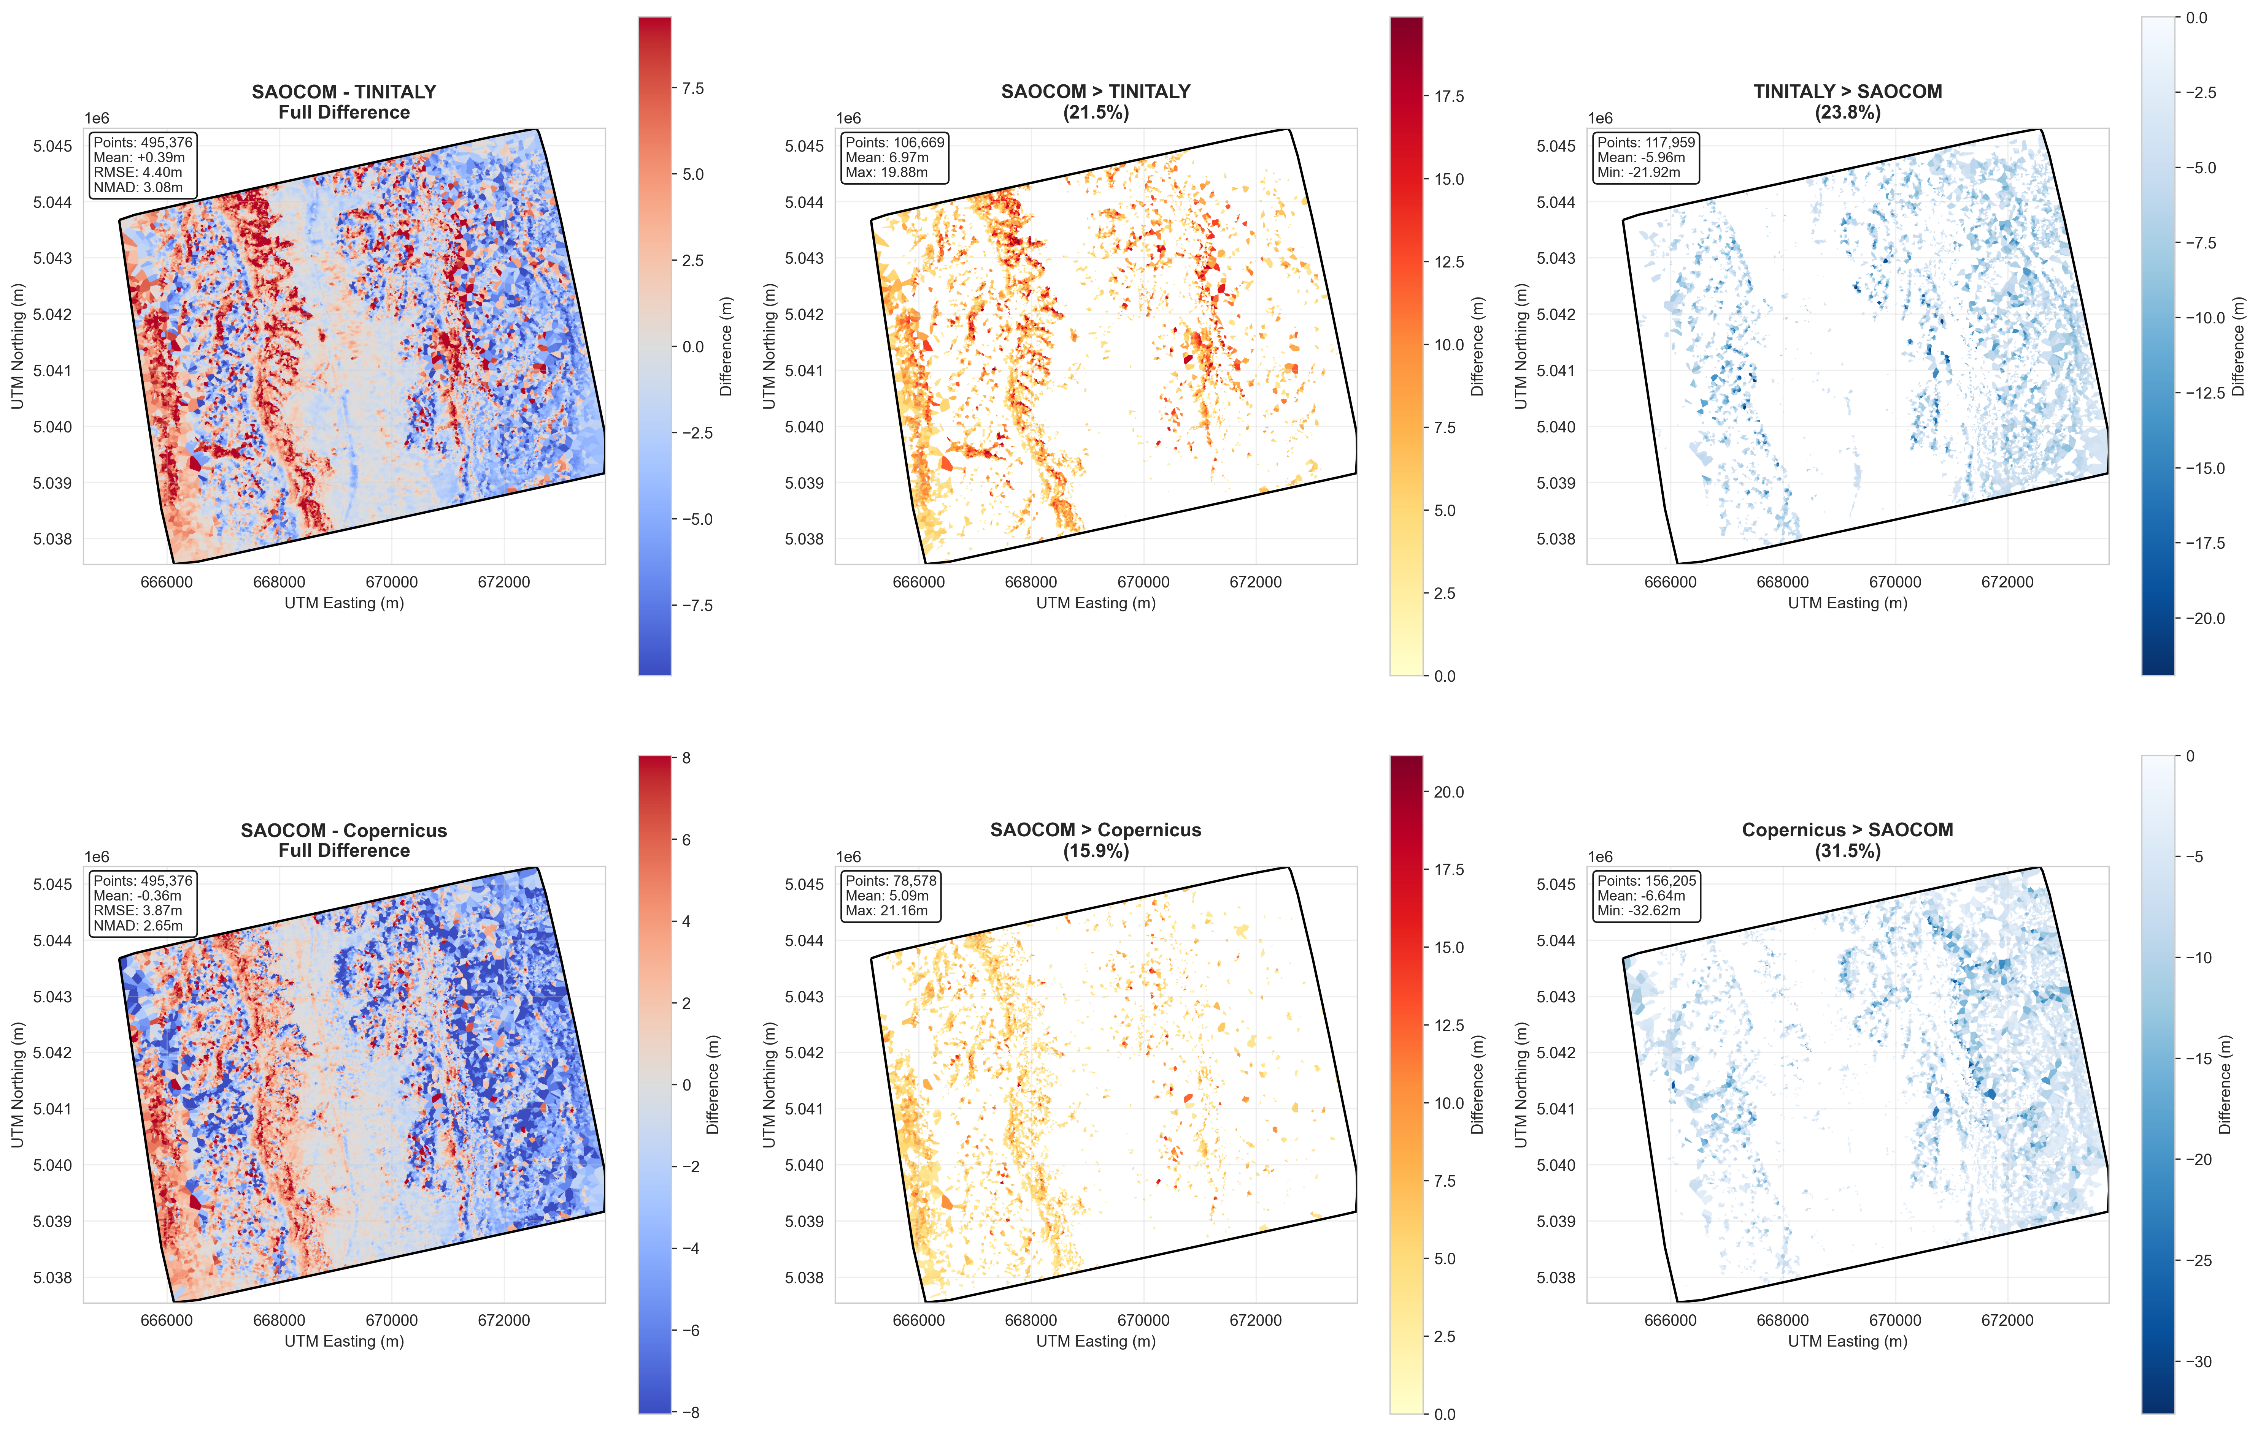
SAOCOM Comparison Visualization

Slide 22
Scatter Plot Comparisons
Scatter plots SAOCOM vs TIN, SAOCOM vs Copernicus and TIN vs Copernicus saved as results/scatter_comparisons.png.

Slide 23
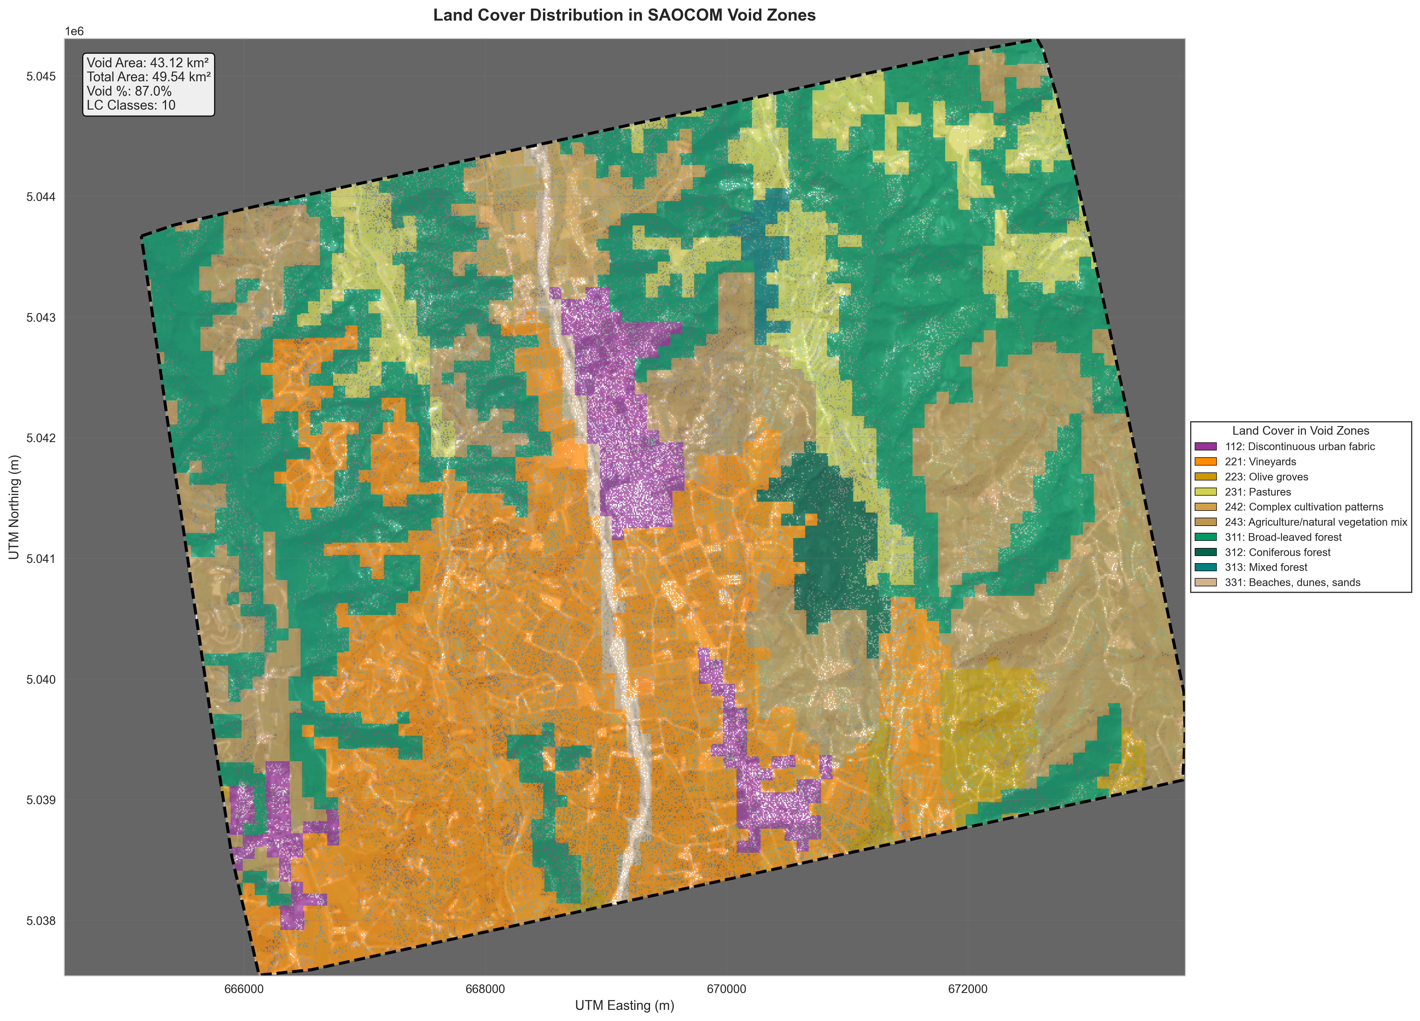
Void Zones by Land Cover - Map

Slide 24
Void Zones by Land Cover - Charts
Chart 1: Top landcover classes by % of class void (descending).
Chart 2: Top classes by % of total void area (largest absolute contributors).
Charts saved as results/voids_by_landcover_charts.png.

Slide 25
Land Cover with Voids - Outlined Visualization
Detailed landcover-with-voids map: results/landcover_voids_outlined.png

Slide 26
Individual Coverage/Void Maps per Class
One per class: coverage (hatching), void (white with dot hatching), saved as landcover_{code}_{name}_coverage_void.png
Statistics shown: total area, coverage area, void area, coverage %, void %.

Slide 27
Coverage Summary Table
Full table of per-class coverage and void % exported to results/coverage_by_landcover.csv.
Columns: code, name, coverage_pct, void_pct, total_km2. Sorted by void_pct descending.

Slide 28
Processing Outputs Summary
Resampled DEMs: results/tinitaly_10m.tif, results/copernicus_10m.tif
Masked DEMs: results/tinitaly_10m_masked.tif, results/copernicus_10m_masked.tif
CORINE remapped: results/corine_remapped.tif, results/corine_10m_masked.tif
Void mask: results/saocom_void_mask.tif
Figures: saocom_comparison_directional.png, voids_by_landcover_map.png, voids_by_landcover_charts.png
Individual maps: landcover_{code}_{name}.png (44 files) and *_coverage_void.png

Slide 29
Code Structure Summary
1) Data loading & standardization (SAOCOM CSV, TINITALY, Copernicus, CORINE, Sentinel).
2) CRS standardization to EPSG:32632 and resampling to 10 m grid.
3) Coherence filtering, k-NN cleaning, hull mask generation.
4) Height calibration via median offset (stable points, γ ≥ 0.8).
5) Statistical validation: classical & robust metrics (RMSE, NMAD, MAE, LE percentiles).
6) Land cover stratification and void analysis; comprehensive visualizations exported.

Slide 30
Notes & How to Re-run
To reproduce: run the Jupyter notebook provided (saocom_v3_merged) in a Python environment with geopandas, rasterio, scipy, scikit-learn, matplotlib.
This PPTX script reads figures and files from results/. If results/ is not present, slides still contain textual summaries.
PPTX saved as: SAOCOM_DEM_Validation_Study.pptx
Contact: use the notebook's author metadata for provenance and data lineage.

